Slide 1


VV
VERVE BRIDGE
TASK 2:
Big Game Census Data Visualization
- KHUSHI

Slide 2

TABLE OF CONTENT
INTRODUCTION
OBJECTIVE
METHODOLOGY
PROBLEM STATEMENT
DATA COLLECTION & CLEANING
DATA ANALYSIS
DASHBOARD & KEY INSIGHTS
RECOMMADATION
SUMMARY

Slide 3

INTRODUCTION
The Big Game Census Data Visualization project aims to analyze and visualize data related to players' demographics and their geographic distribution. By examining factors such as age, weight, years played, and birthplace, this project seeks to uncover patterns and trends within the big game population. Using tools like Excel for data cleaning and preparation, the analysis will provide insights into the factors influencing player success and regional talent distribution. The ultimate goal is to present these findings through comprehensive data visualizations, offering valuable perspectives for decision-making and strategic planning in the big game ecosystem.

Slide 4

OBJECTIVE
The objective of the "Big Game Census Data Visualization" project is to analyze and visualize demographic and geographical data related to players in a sports context. By examining datasets that include information such as player demographics, geographical locations, population estimates, and player statistics, the project aims to uncover patterns and insights that can enhance the understanding of player distribution, team composition, and population demographics associated with sports players.

Slide 5
METHODOLOGY
Data Cleaning
Statistical Analysis
Visualization
Modeling
Reporting
Data Collection
ExploratoryData Analysis

Slide 6
PROBLEM STATEMENT
"Sports organizations and analysts often face challenges in understanding the demographic and geographical distribution of players, which can affect talent scouting, team composition, and strategic planning. This project aims to address this challenge by analyzing various datasets containing information about players, including their demographics, birthplaces, teams, and the population demographics of their locations. Through detailed data analysis and visualization, the project seeks to uncover patterns and insights that can inform decision-making, enhance player recruitment strategies, and provide a comprehensive understanding of the relationship between player characteristics and geographical factors.".

Slide 7
DATA COLLECTION
The dataset provided by VerveBridge offers a detailed view of player and demographic information essential for sports analytics. It includes player-specific details such as name, jersey number, position, age, weight, and college affiliations. Additionally, the dataset captures geographical aspects, including the player's birthplace, state, and relevant population estimates for 2016. Geographic identifiers and coordinates (latitude and longitude) for the birthplace enhance spatial analysis. The dataset also includes the number of players from each city and the total number of records. This comprehensive collection enables a thorough analysis of player demographics, geographic distribution, and their correlation with performance metrics.

Slide 8
DATA CLEANING
The steps are taken to clean the data :
Removed Unnecessary Columns: Deleted irrelevant columns to simplify the dataset.
Removed Duplicates: Identified and removed duplicate records to ensure accuracy.
Handled Missing Values: Filled missing values with appropriate defaults or removed
incomplete rows.
Standardized Data Formats: Ensured consistent formatting for dates, numbers, and text.
Replaced Inconsistent Values: Updated inconsistent values, such as replacing 'R' with '6’.
Validated Data: Applied data validation to ensure all values were within expected ranges.

Slide 9
.
I
DATA ANALYSIS USING EXCEL
The steps are taken to analysis : EDA
I used Excel to analyze the data by summarizing key statistics and creating pivot tables to see overall trends. Charts like bar graphs and line graphs helped visualize player information and distributions. I also checked for relationships between different variables and filtered the data to examine specific groups. This process provided a clear view of the data patterns and insights.

Slide 10
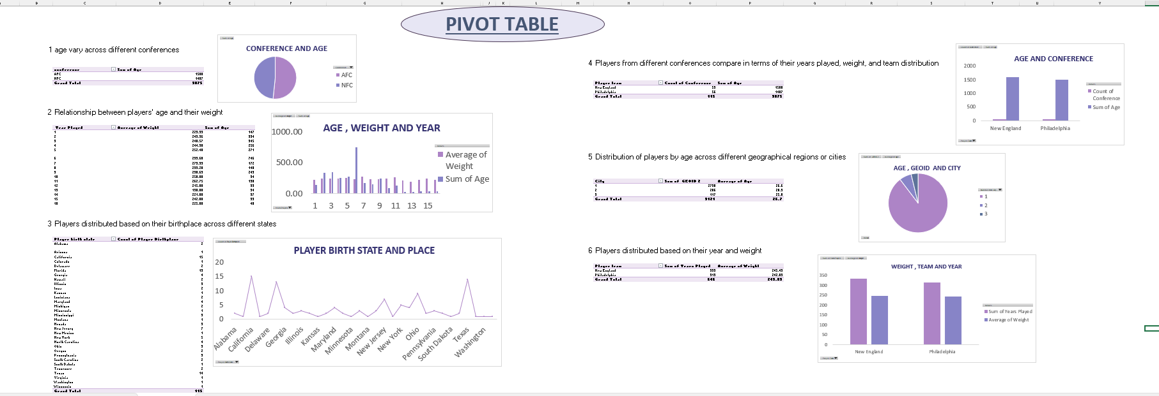
PIVOT TABLE AND CHART

Slide 11
KEY INSIGHT
Age Variation Across Different Conferences : Analyze the age distribution within each conference to identify if some conferences have younger or older players compared to others.
Relationship Between Players' Age and Weight : Determine if there is a correlation between a player's age and their weight, which might reveal trends in player physique as they age.
Players Distributed Based on Their Birthplace Across Different States : Map player birthplaces to states to understand regional representation and identify any dominant states.

Slide 12
KEY INSIGHT
Distribution of Players by Age Across Different Geographical Regions or Cities : Visualize how players' ages are distributed across various cities or regions to spot trends or concentrations.
Players from Different Conferences Compared in Terms of Years Played, Weight, and Team Distribution : Compare players' years played, weight, and team affiliations across conferences to identify any significant differences or patterns.
Players Distributed Based on Their Year and Weight : Examine how players' years in the league relate to their weight to identify if weight trends shift over time.

Slide 13
DATA VISUALIZATION
The steps are taken to analysis :
I used Power BI for data visualization, creating interactive dashboards and charts to represent player demographics and geographical distributions. Using Power BI, I developed interactive reports and visualizations that illustrated player demographics and geographic distributions. These visuals provided clear insights and allowed for effective exploration of key trends and patterns in the data.

Slide 14
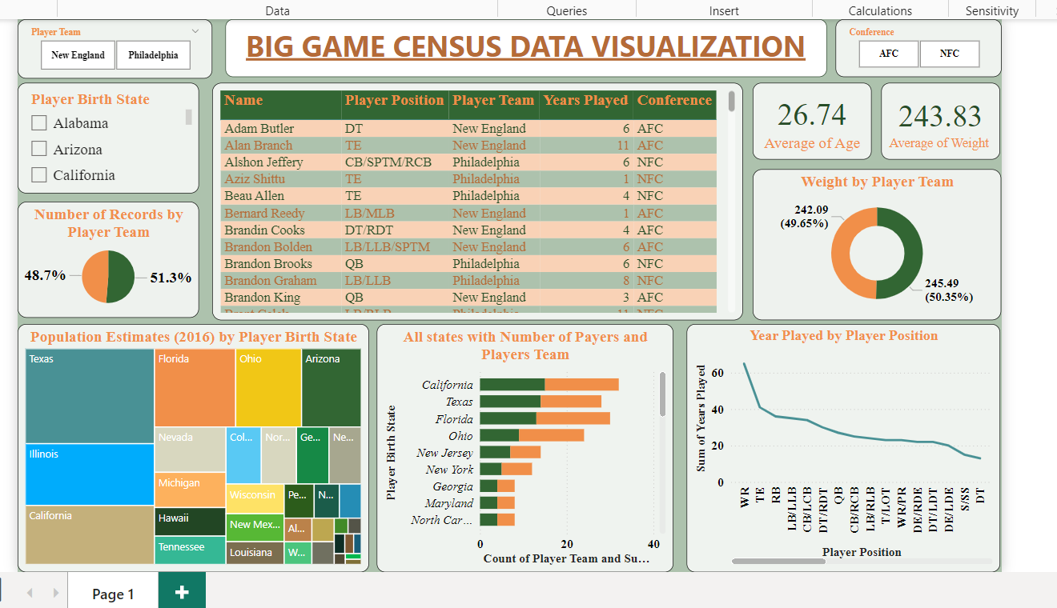
BIG GAME CENSUS DASHBOARD

Slide 15
KEY INSIGHT
Player Team Distribution : The pie chart shows a near-equal distribution of players between New England (48.7%) and Philadelphia (51.3%), indicating a balanced dataset.
Average Age and Weight : Players have an average age of 26.74 years and an average weight of 243.83 pounds, providing a general profile of player demographics.
Player Birth State and Population Estimates : Players primarily come from Texas, Florida, Ohio, Arizona, and Illinois, highlighting key states with a significant contribution to the player pool.

Slide 16
KEY INSIGHT
State-wise Player Distribution : California, Texas, and Florida have the highest number of players, suggesting strong football programs or larger talent pools in these states.
Player Positions and Experience : Wide receivers (WR) and tight ends (TE) show a higher total of years played, while defensive tackles (DT) and safeties (S/SS) generally have shorter careers.
Weight Distribution by Team : The average weight is nearly evenly split between the teams, with New England averaging 242.09 pounds and Philadelphia 245.49 pounds.

Slide 17
RECOMMANDATIONS
Based on this project, here are recommendations:
Focus Scouting : Target key states like California, Texas, and Florida, while exploring underrepresented regions for hidden talent.
Customized Training : Develop training programs for positions with shorter careers, emphasizing injury prevention and conditioning.
Data-Driven Strategies : Use analytics to maintain balanced rosters and inform strategic decisions for team performance.
Community Engagement : Engage with high-contributing states through football camps and clinics to foster relationships with emerging talent.
Prioritize Player Health : Implement mental and physical health support programs to sustain and extend player careers.

Slide 18

SUMMARY
The Big Game Census Data Visualization project analyzed player demographics and team compositions to uncover key trends. Using datasets on player information, birth states, and team data, the analysis highlighted the concentration of talent in states like California, Texas, and Florida. It also provided insights into player distribution across positions and teams, along with age and weight metrics. These findings informed recommendations for talent scouting, customized training, and player health strategies to improve team performance and player longevity. The project offers a data-driven foundation for decision-making in sports management.

Slide 19





THANK YOU
9306247377
chhabrakhushi26@gmail.com
H.No.-254, Inderpuri Mohalla, ,Palwal, 121102
WWW.VERVEBRIDGE.COM

